Slide 1



Sales Insights Atliq Hardware
View in Power BI
Last data refresh:
3/2/2023 1:26:54 PM UTC
Downloaded at:
3/2/2023 3:04:47 PM UTC

Slide 2
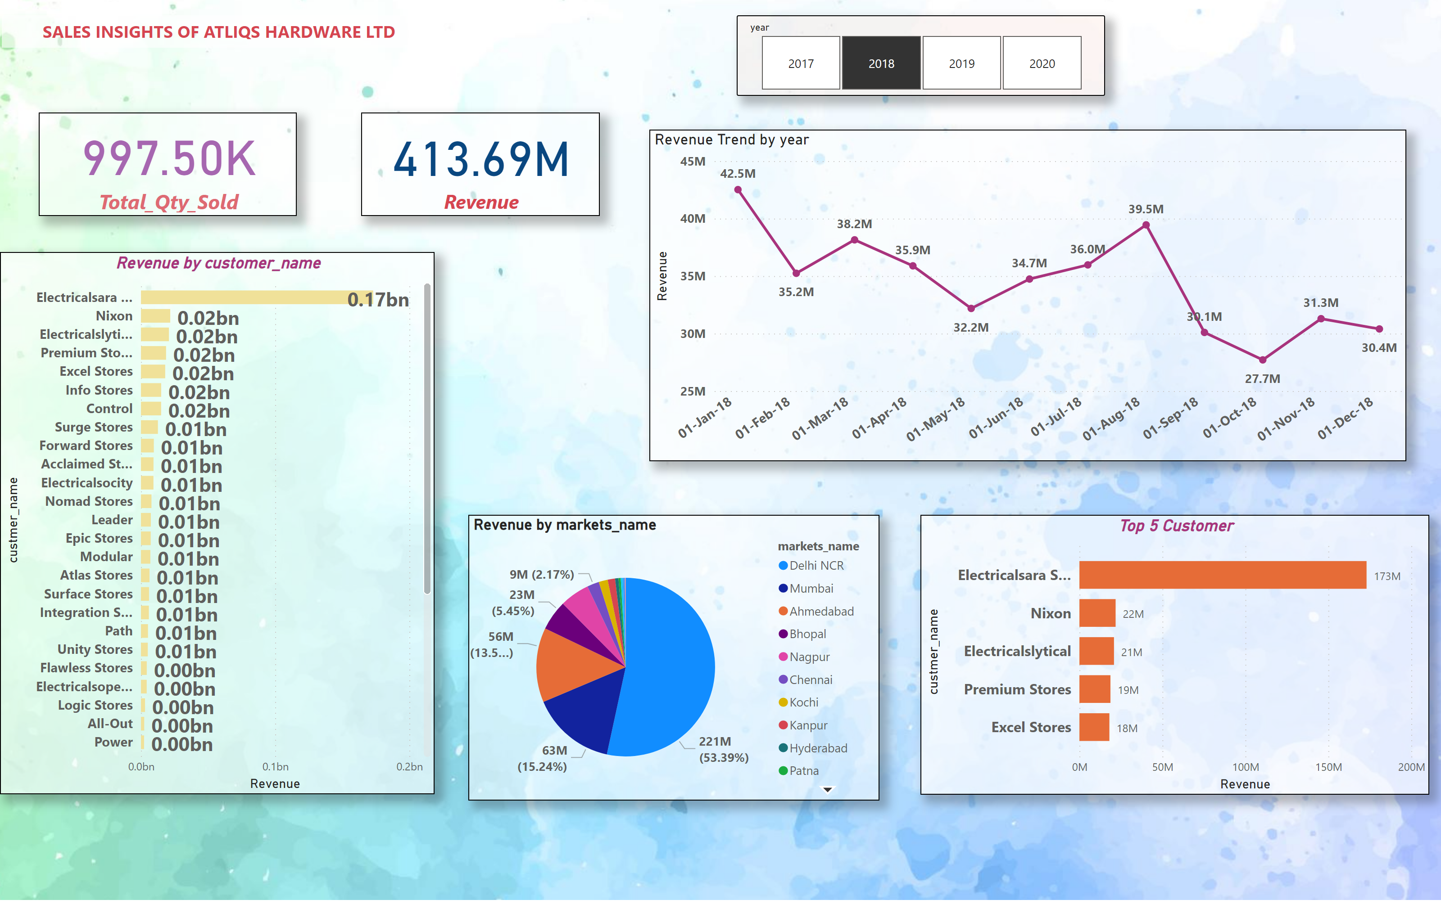
Page 1
Notes:
card
No alt text provided
card
No alt text provided
textbox
No alt text provided
Revenue by customer_name
No alt text provided
slicer
No alt text provided
Revenue Trend by year
No alt text provided
Top 5 Customer
No alt text provided
pieChart
No alt text provided

